Slide 1
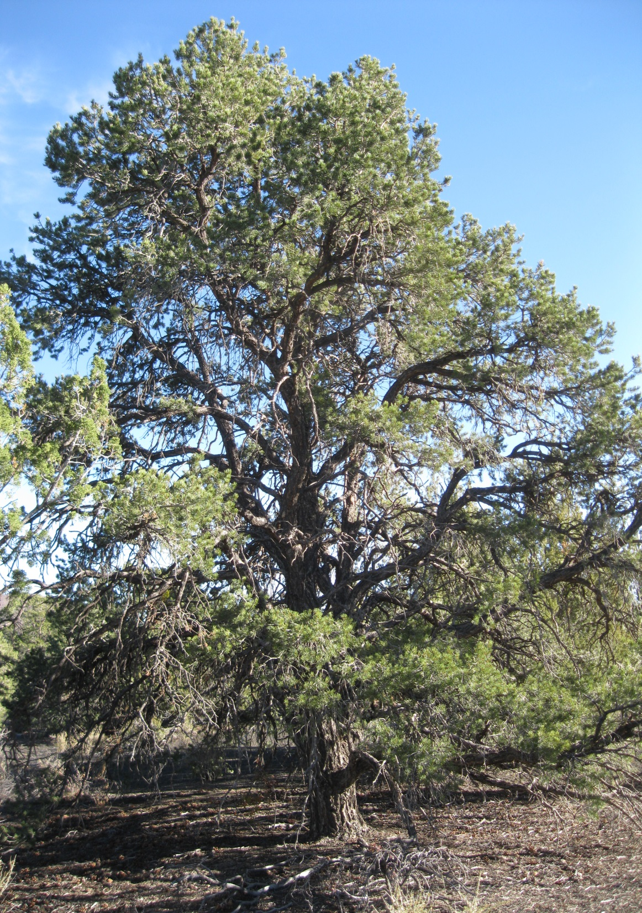


Genetic vs. Environmental Determinants of Ectomycorrhizal
Fungi in Colorado Pinyon Pine
(Pinus edulis)
Adair Patterson
Mentors: Dr. Kitty Gehring
& Dr. Lluvia Flores-Renteria

Slide 2
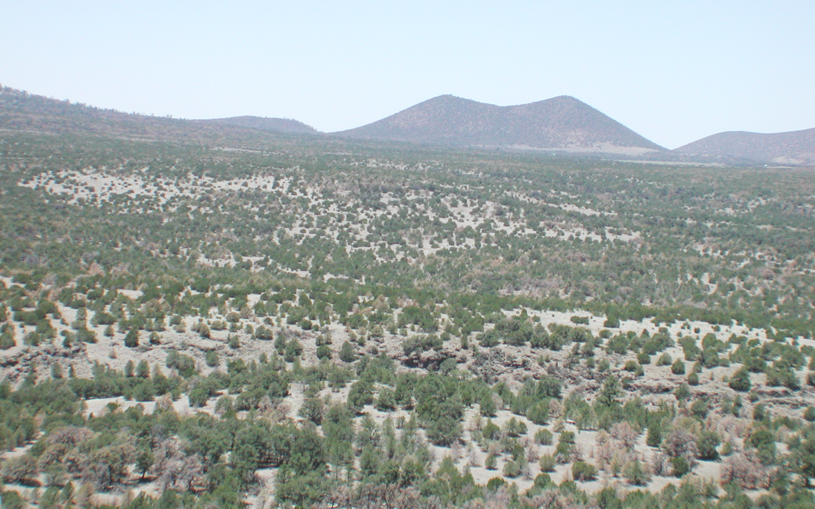
May 17, 2003 North of San Francisco Peaks
Photo: Neil S. Cobb, NAU

Slide 3
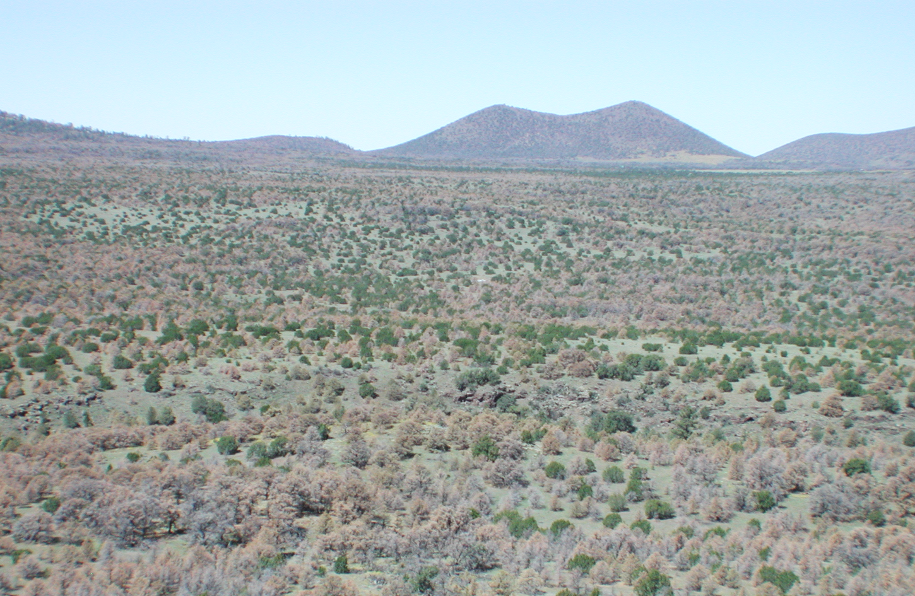
September 20, 2003
Photo: Neil S. Cobb, NAU

Slide 4
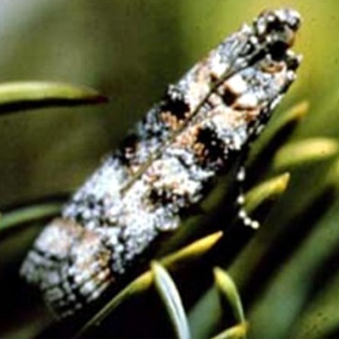
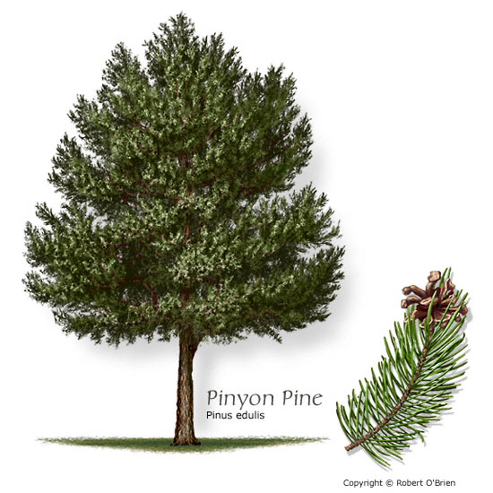
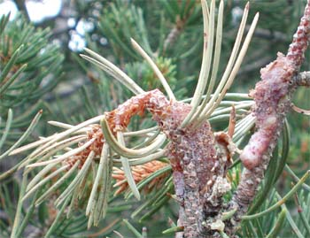

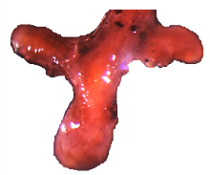
Introduction
Ectomycorrhizal Fungi (EMF): Symbiotic fungi
that increase the
surface area of tree
roots to help in
the uptake of water
and nutrients in exchange for carbohydrates
Pine Tip Moth:
Consumes terminal shoots of susceptible pinyon trees, creating a stunted, shrub-like appearance
Whitham & Mopper 1985

Slide 5
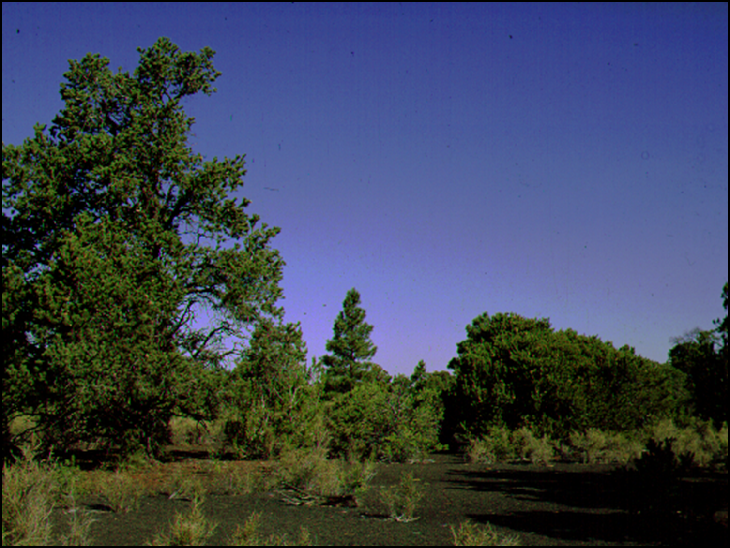
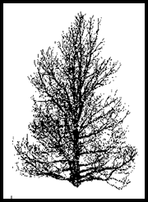
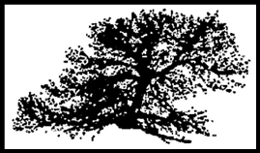
Moth Susceptible
Moth Resistant

Slide 6
Resistant vs Susceptible
Resistant Genetics
Susceptible Genetics
Ascomycota EMF
Dominant Communities
  Drought tolerant spp.
Basidiomycota EMF Dominant Communities
68% Drought Mortality
28% Drought Mortality
Sthultz et al. (2009)

Slide 7
Hypotheses
EMF communities on resistant vs. susceptible pinyons are determined by environmental factors such as high and low water treatments.
EMF communities are determined by genetics (traits passed on from one or both parents).
Different EMF communities on resistant vs. susceptible progeny

Slide 8
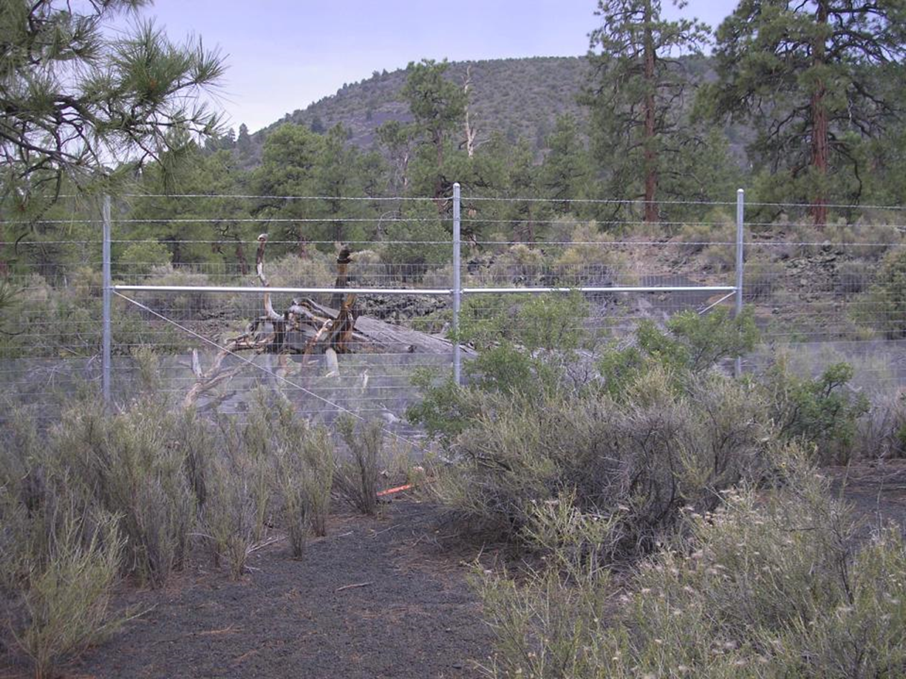
Pinyon Common Garden
Location: Sunset Crater National Park
2500 Seedlings- Planted in 2009-2010
Water Manipulation
High water = 4.79% soil moisture
Low water = 2.4 % soil moisture
No water = 0.88 % soil moisture

Slide 9
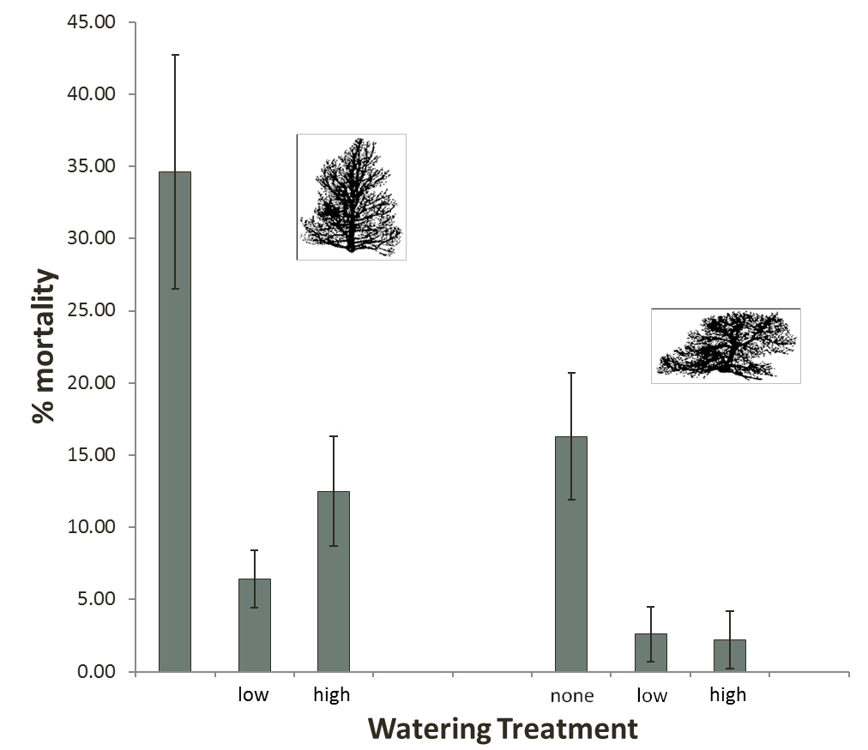

Seedlings from Susceptible Mothers have Lower Mortality
Watering regime F = 12. 9, P <0.0001
Resistance F = 8.9, P = 0.004
Resistant
Susceptible
none
SEEDLING MORTALITY
(2012-2013)

Slide 10

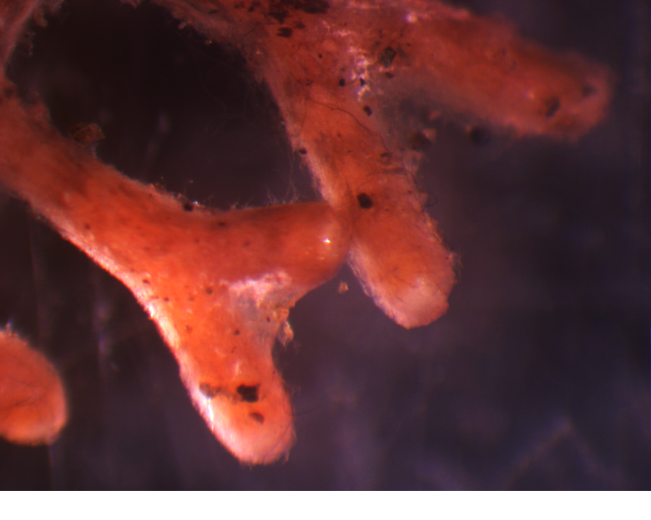
Data & Methods
Morphological analysis of EMF
on roots
EMF Sampling:
Seedlings
[Susceptible & Resistant]
2 moisture treatments (High & Low)
17 resistant
18 susceptible
DNA extraction
PCR (Polymerase Chain Reaction)
Sanger Sequencing of DNA

Slide 11
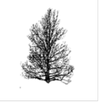

Data from Morphotype Analysis (Preliminary Data)
Resistant vs susceptible
mothers F = 2.373, P = 0.075
High vs low water
F = 0.977, P = 0.414
Water-resistance interaction
F = 0.771, P = 0.517
High water
Low water

Slide 12
Conclusions so far
EMF communities are nearly statistically significant in their different associations between susceptible and resistant trees
Environmental factors (watering treatments) had no significant effect on EMF communities
Next Step: Look at more detailed effects of genetics on inheritance of EMF communities
-Compare progeny (from the common garden) to parents growing in the field

Slide 13



Acknowledgements
Thanks to:
NASA Space Grant
Arizona Space Grant Consortium
Hooper Undergraduate Research Award
Northern Arizona University
Kitty Gehring
Lluvia Flores-Renteria
Andy Krohn
The Gehring Lab Group

